Slide 1
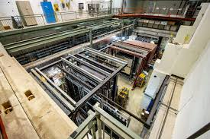
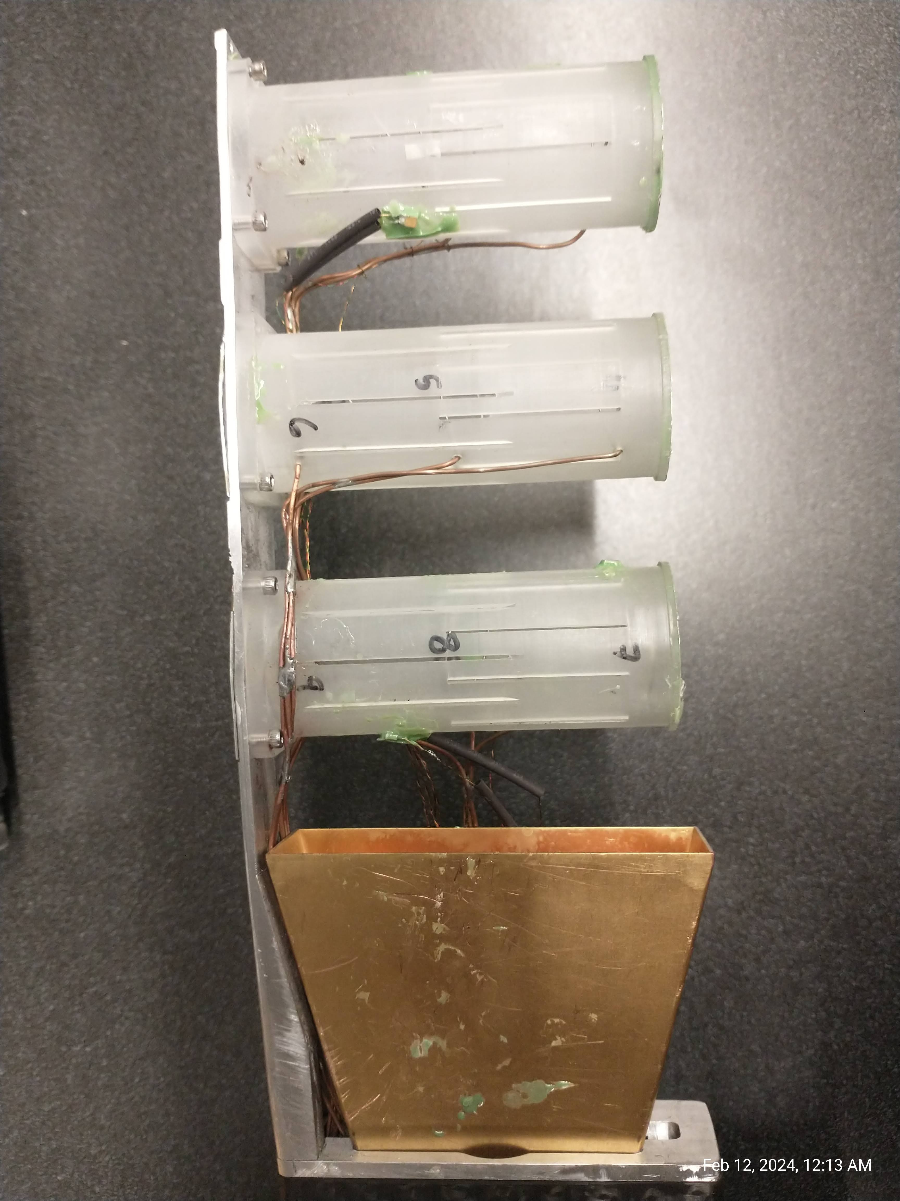
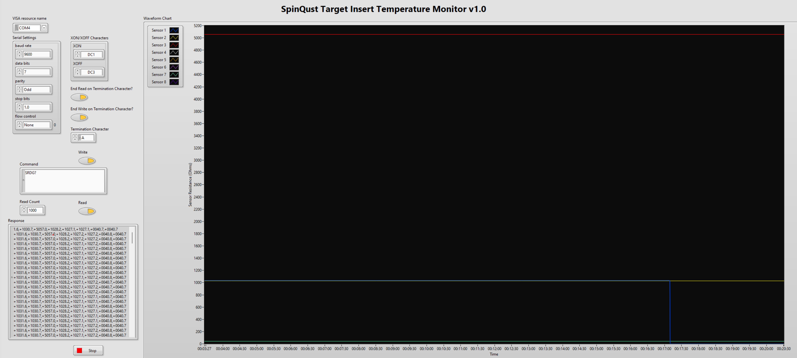

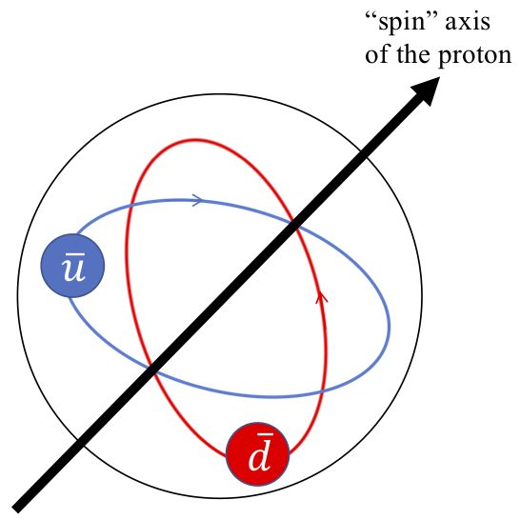

Temperature monitoring VI development using Labview for Target Insert
Notes:
This is the weekly update for the time period up to 2nd of February

Slide 2
Assigned Task
Create a Labview VI to plot the readout of the “Lake Shore Model 218”
Output interface Serial Port with RS-232 protocol
Number of channels to read: 8
Temperature sensor model:
Vishay RCWP, 1K Ohm Chip Resistor: http://www.vishay.com/docs/31011/rcwp.pdf
Cernox sensor: https://twist.phys.virginia.edu/work/Drell-Yan/Manuals/CernoxInstallation.pdf
Already created github repository for version tracking and sharing my contributions:
https://github.com/chatuu/e1039-Target-Insert-Labview/tree/main
Notes:
Today I am gonna be mainly focusing on the production campaign carried to reconstruction over cosmic data.
In this talk I would like to outline:
the selection criteria used to select files for reconstruction.
Current progress we have made so far,
Results obtained during reonstruction
The challenges I am facing when running reconstruction
The next steps
I already shared newly reconstructed dataset of 400 files to proceed efficiency study. I believe 400 files is a reasonable sample to proceed to preliminary efficiency study

Slide 3
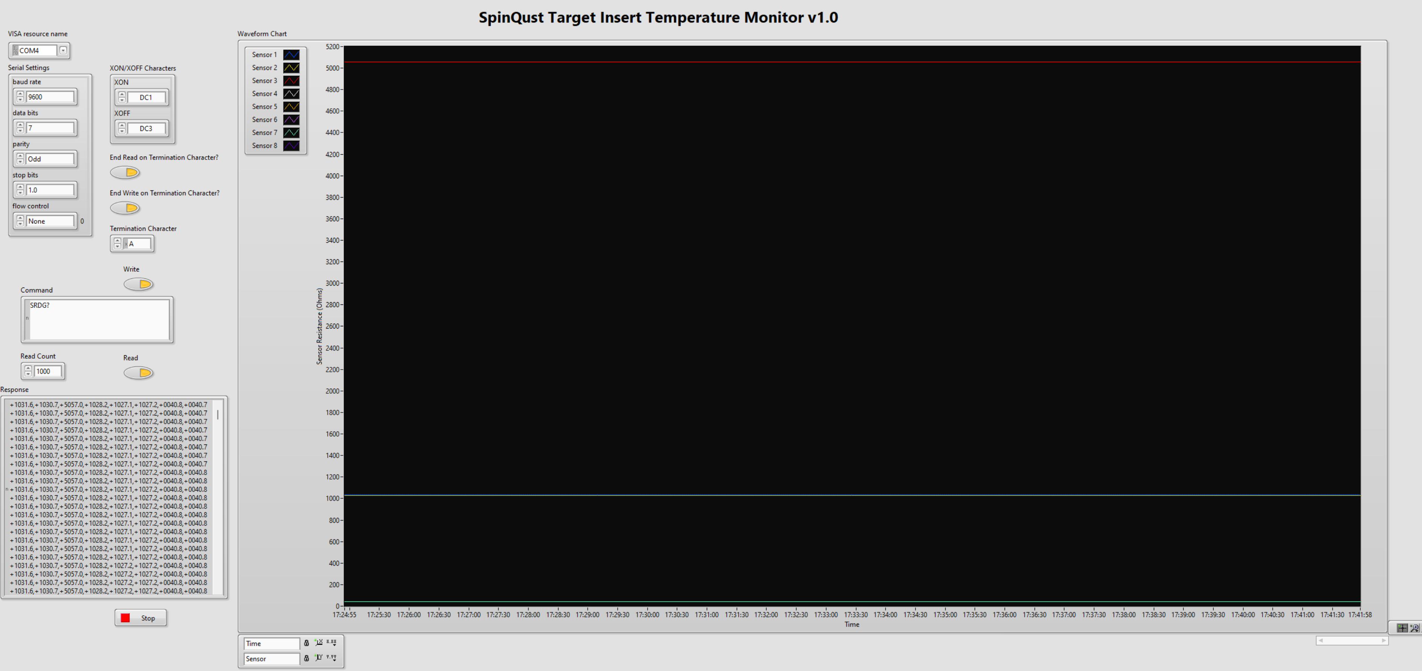
Current Progress (VI: Front Panel)
Notes:
Let's talk about NOvA experiment

Slide 4
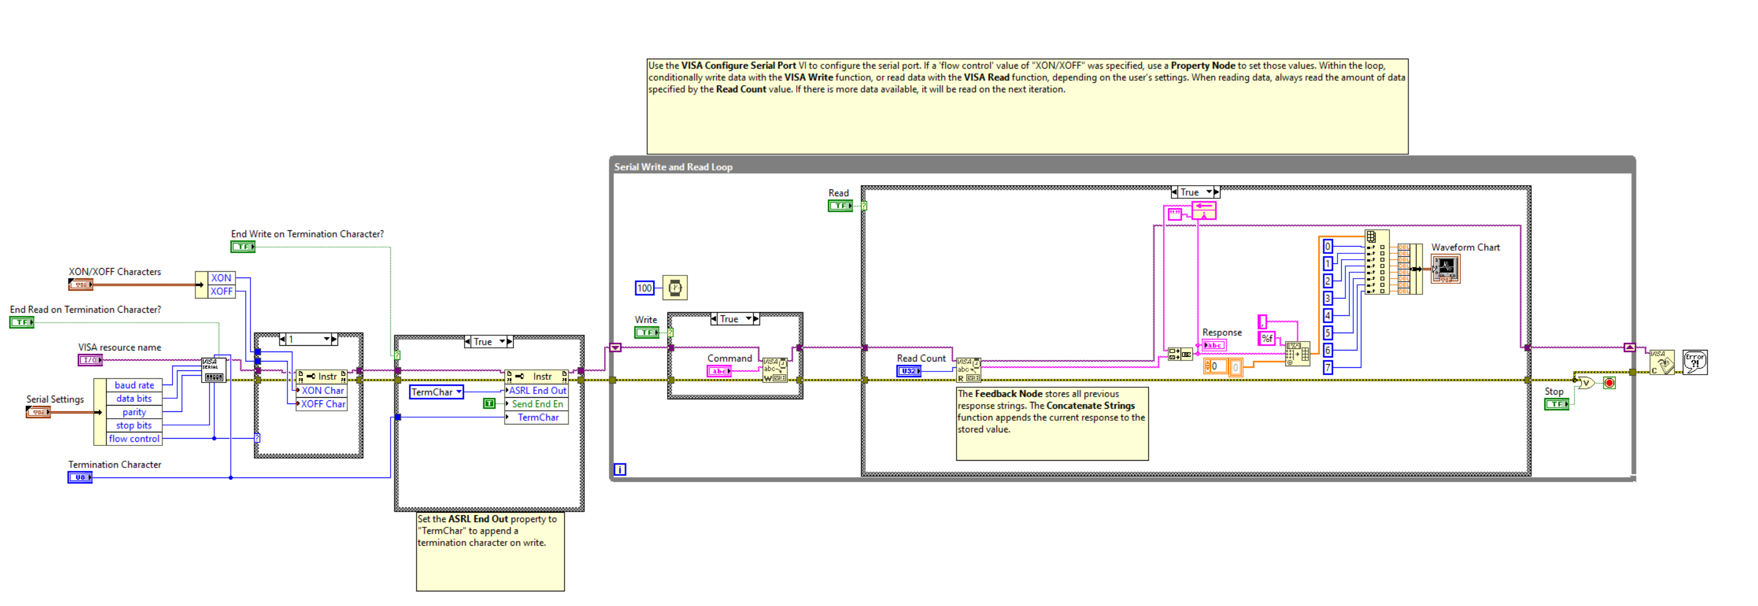
Current Progress (VI: Block Diagram)
Notes:
Let's talk about NOvA experiment

Slide 5
Next Steps
Plot temperature instead resistance
Modifying front Panel of the VI based on the recommendations
Updating github repository with the latest improvements
Notes:
Let's talk about NOvA experiment

